Slide 1
A Study Of The Book Of Revelation
August 9, 2020

Slide 2
Letters To Seven Churches of Asia
(Revelation 2-3)
Some were good (Smyrna, Philadelphia)
Some were good / bad (Ephesus, Pergamum, Thyatira, Sardis)
One was bad (Laodicea)

Slide 3
Revelation 3:7-13
P
H
I
L
A
D
E
L
P
H
I
A
Named after King Attalus II Philadelphus, of Pergamum (159-138 BC). Named the city out of affection for his brother Ecumenus II.
Agricultural town.
Population of about 20,000.
“Missionary” city – for the purpose of spreading Greek culture and language.

Slide 4
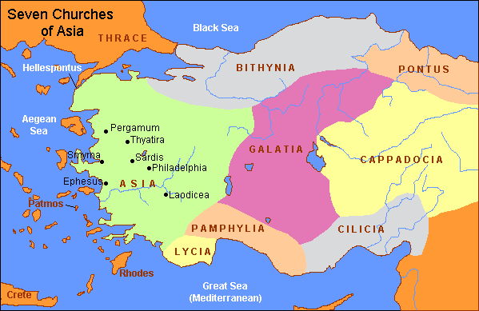

Slide 5
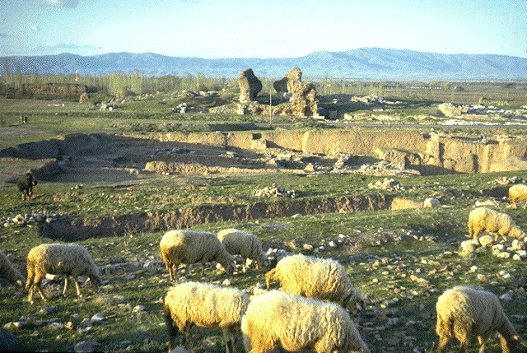
Albert Barnes notes, “The country, as viewed from these hills, is extremely magnificent – gardens and vineyards lying at the back and sides of the town, and before it one of the most beautiful and extensive plains of Asia.”
Barnes, Albert, Barnes on the New Testament, “Revelation” Volume 11, Page 92.

Slide 6
Fleeing Philadelphia
In 17 AD the city, built on a fault line, was leveled by an earthquake. “Philadelphia has no trustworthy walls, but daily in one direction or another they keep tottering and falling apart” (Strabo, c. 63 BC - c. 21 AD)
Jesus probably alludes to the history of fleeing out of the city for safety (3:12)

Slide 7
Revelation 3:7-13
Background / Circumstance
We know nothing about the establishment or beginning of this church
Faced some opposition – from Jews

Slide 8
Revelation 3:7-13
A Faithful Church
Revelation 3:7-13
The Salutation (verse 7)

Slide 9
Revelation 3:7-13
A Faithful Church
Revelation 3:7-13
“He who is holy …” This reflects His character.
This indicates the authority of Jesus as deity. Jesus identifies himself with the absolute holiness of God. The same terms are applied to God in Revelation 6:10 (cf. Isaiah 6:1-5; 40:25).
Christ is set forth as the ideal demanded by God of absolute separation (cf. 1 Peter 1:16) from the profane and sinful.
His moral character is without spot or blemish. 1 Peter 2:21, 25. He committed no sin. Hebrews 4:15; 7:26.

Slide 10
Revelation 3:7-13
A Faithful Church
Revelation 3:7-13
“… And True …” He is dependable, genuine, real … He is not a false prophet. He is God’s spokesman.
This was a favorite expression with John. Of the 27 times this word is used in the NT, it is used 22 times by John.
Jesus is the “true light” (John 1:9); “The true bread” (John 6:32); “The true vine” (John 15:1); “The true God” (1 John 5:20); and “The faithful and true witness” (Revelation 3:14).

Slide 11
Revelation 3:7-13
The Salutation (verse 7)
Christ alone “has the Key (singular) of David.” That is the highest power and authority in the kingdom of God (Matthew 16:19; 28:18; Revelation 5:5).
1. Jesus is of the seed of David (Isaiah 9:6-7, Luke 1:30-33; Matthew 22:41-45).
2. He is raised to sit on the throne of David (Acts 2:30-33).
3. He is both Lord and Christ (Acts 2:36).

Slide 12
Revelation 3:7-13
The Salutation (verse 7)
Christ alone “has the Key (singular) of David.”
4. He possesses all authority (Matthew 28:18; cf. Ephesians 1:19-23).
a. Over “angels and authorities and powers” (1 Peter 3:22).
b. Over the church (Ephesians 1:22-23).
c. Over the kings of the earth (Revelation 1:5).
d. Over death and Hades (Revelation 1:8).
5. Destroys the idea of Christ’s reign on David’s throne being future! (Jewish claims and premillennial claims.)

Slide 13
Revelation 3:7-13
The Salutation (verse 7)
“He that openeth and no man shutteth; he that shutteth and no man opens.” (Revelation 3:7)
1. Jesus alone has authority to admit, to include, or exclude.
2. The Lord alone adds to the church (Acts 2:47).
3. He gives terms of entrance. (Luke 24:47; Acts 2:38; John 3:3-5; John 8:24).
4. There is no other way to enter, except that which the Lord has opened. (John 14:6; Acts 4:12).
5. He who opens … who shuts … Jesus ALONE has that power.

Slide 14
Revelation 3:7-13
The Salutation (verse 7)
Came from David – Matthew 1:1
Lineage of David – 2 Samuel 7:12-14
A King like David – John 18:36,37
Has all authority – Matthew 28:18; Colossians 3:17
“His character of holiness and truth is his right to kingship.”
Ray Summers, Worthy is the Lamb, Page 122

Slide 15
Revelation 3:7-13
A Faithful Church
Revelation 3:7-13
The Salutation (verse 7)
The Praise (verses 8, 10)
(No condemnation in this letter.)
“I know thy works (behold, I have set before thee a door opened, which none can shut)”
This metaphor is commonly used by Paul to indicate a good opportunity for preaching the gospel (Acts 14:27; 1 Corinthians 16:8-9; 2 Corinthians 2:12; Colossians 4:3).

Slide 16
Revelation 3:7-13
A Faithful Church
Revelation 3:7-13
The Salutation (verse 7)
The Praise (verses 8, 10)
(No condemnation in this letter.)
“I know thy works (behold, I have set before thee a door opened, which none can shut)”
Instead of spreading Greek culture … the gospel to the lost is of much more importance.
Were Faithful!

Slide 17
Revelation 3:7-13
The church must realize that it has an “open door” of service to God and man. There are many “open doors”: personal improvement, evangelization (2 Timothy 2:2; Matthew 9:37-38), hospitality (1 Peter 4:8-9; Hebrews 13:1-2; Acts 16:15), etc.
1. When doing the work of Christ, we must not measure only by our own human abilities, but by faith and prayer, we work the Lord’s will. Ephesians 3:20-21.
2. Too often we excuse ourselves because of the obstacles we see when in reality we should be giving more credit to the strength of the Lord.
3. Abilities vary, but everyone can do something (Matthew 25:14-32)

Slide 18
Revelation 3:7-13
“Thou Hast a Little Strength (power ASV)”
Whether its power was small because of few members, limited economic status, or because of the lowly social order in which they lived, that church’s power was sufficient to achieve Christ’s purpose. God and one make a majority!
Having just one talent does not justify not using it (Matthew 25:14-30)

Slide 19
Revelation 3:7-13
Conversely, it is also an encouraging fact to realize that others may regard us as insignificant and unimportant, but the Lord knows even what the “poor widow” does (Mark 12:41-44; 2 Timothy 2:19).
– Robert Harkrider, Revelation, Page 51

